Slide 1
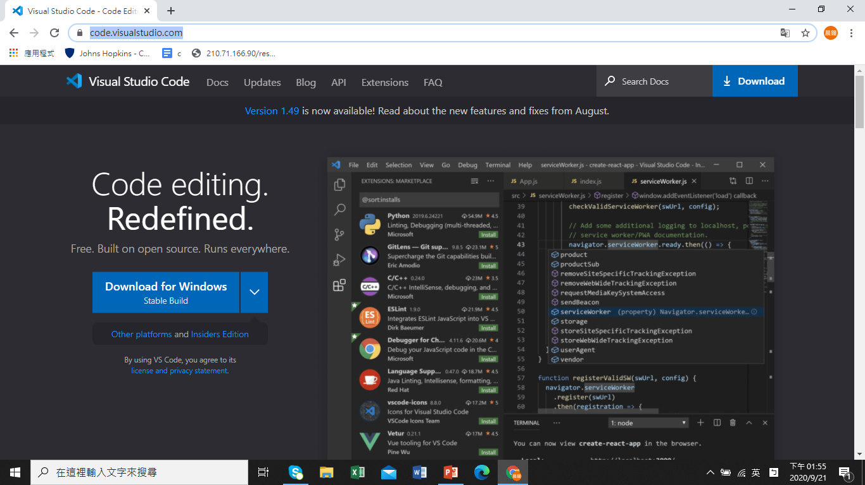
1. visit https://code.visualstudio.com/ to download and install the application

Slide 2
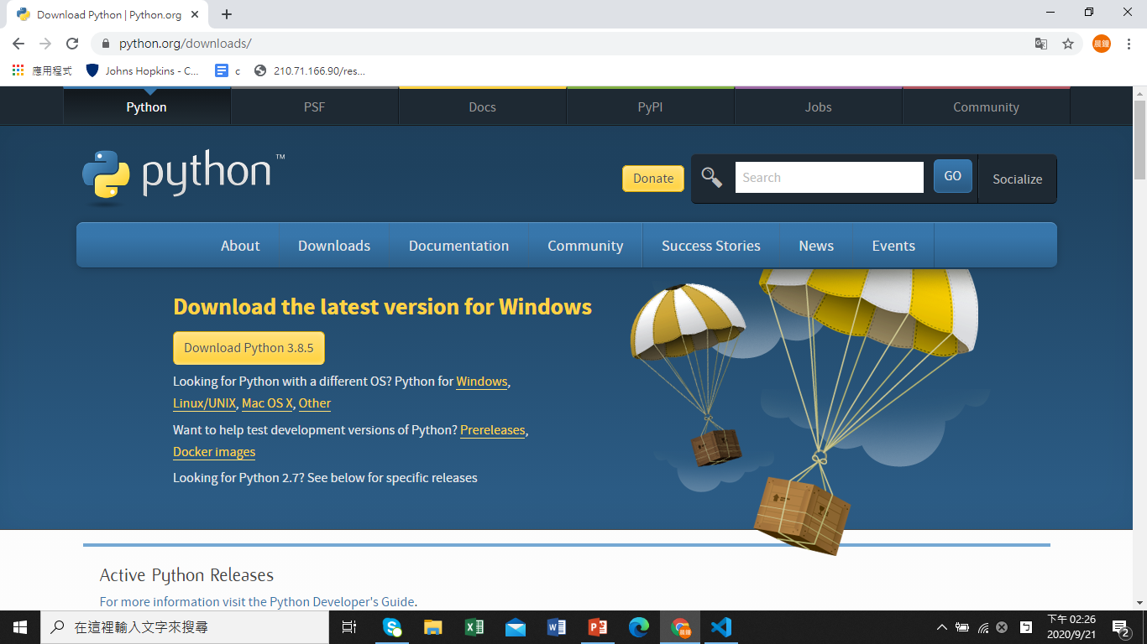
Download and install Python at https://www.python.org/downloads/

Slide 3
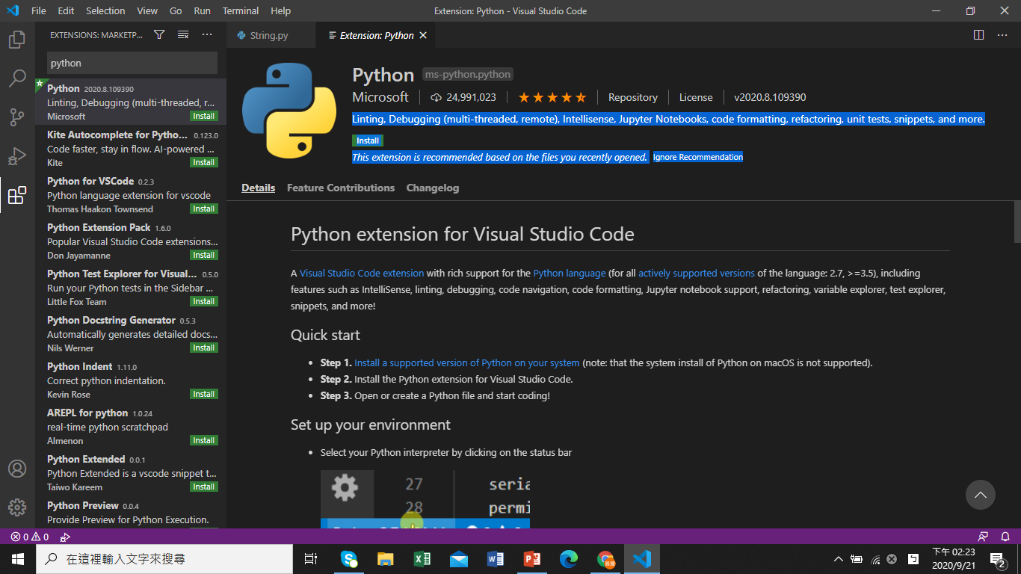
Install python extension in VS Code
Choose Pythonms-python.python extension
Linting, Debugging (multi-threaded, remote), Intellisense, Jupyter Notebooks, code formatting, refactoring, unit tests, snippets, and more.
--Choose Python interpreter
-- Choose Pylint to provide code error suggestions

Slide 4
Pip package installer

Slide 5
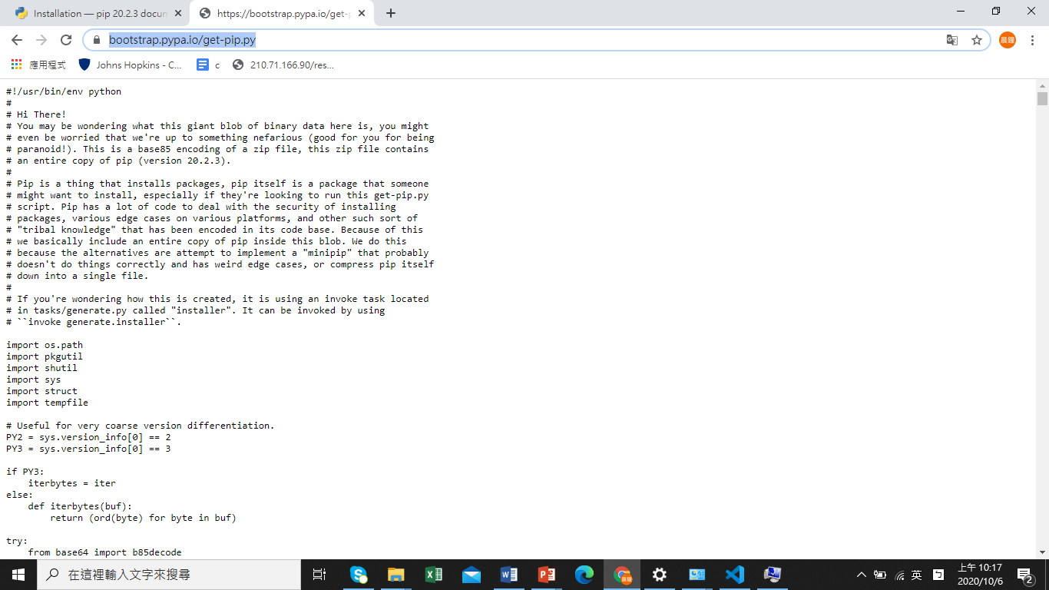
取得https://bootstrap.pypa.io/get-pip.py Script

Slide 6
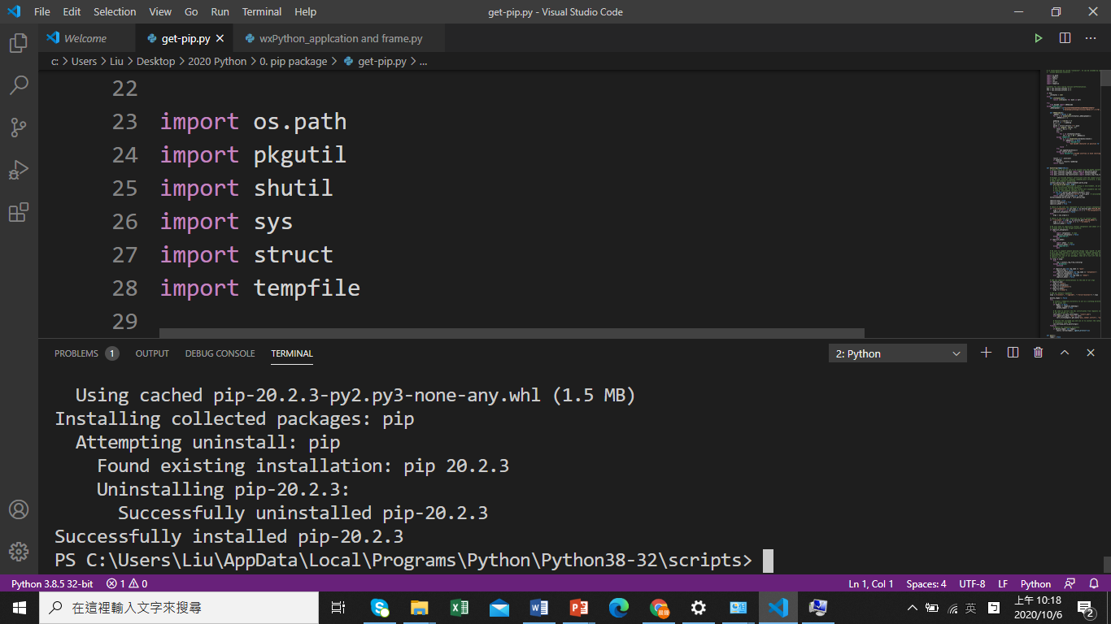
執行get-pip.py

Slide 7
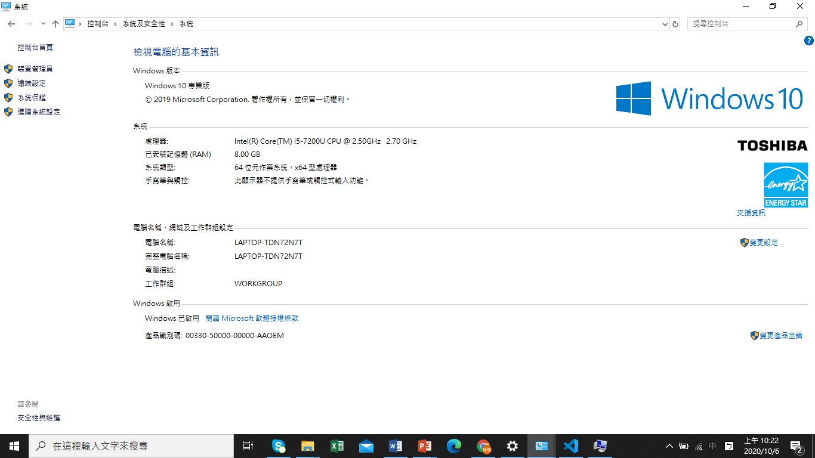
將Python Scripts 目錄放入Windows環境變數

Slide 8
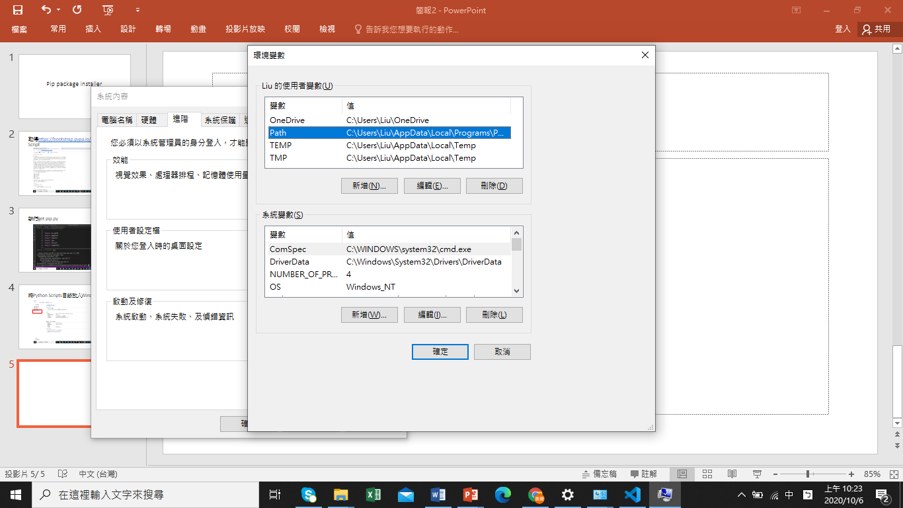
將Python Scripts 目錄放入Windows環境變數

Slide 9
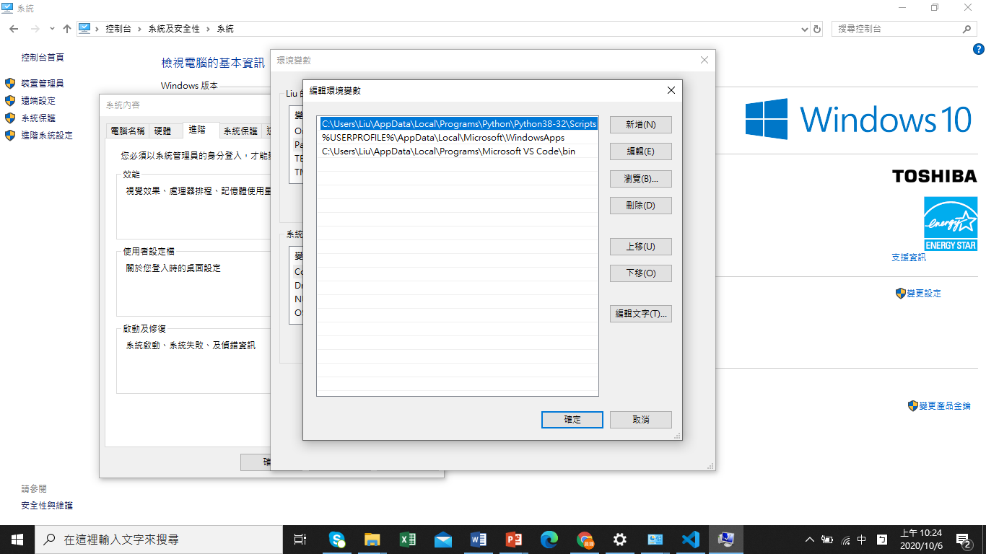
將Python Scripts 目錄放入Windows環境變數

Slide 10
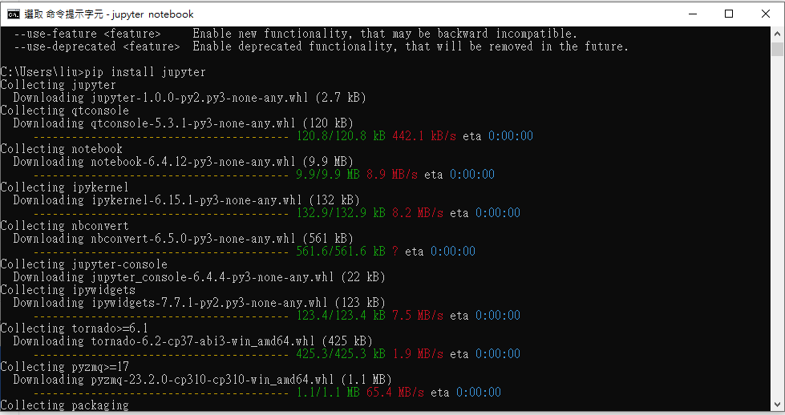
安裝Jupyter

Slide 11
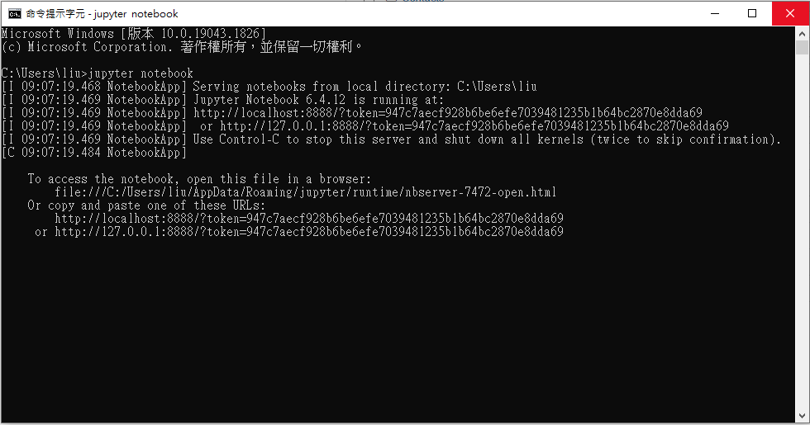
執行Jupyter notebook

Slide 12
Start to code !!! Tutorial available at https://pythonspot.com/
variables, if statement, loops, functions
See
string.py
string_comparision.py
Input.py
Loop.py
Function.py
Recursion.py

